Slide 1
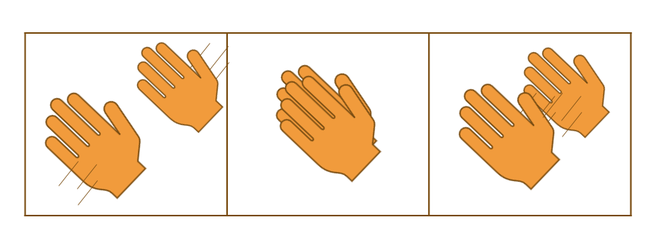
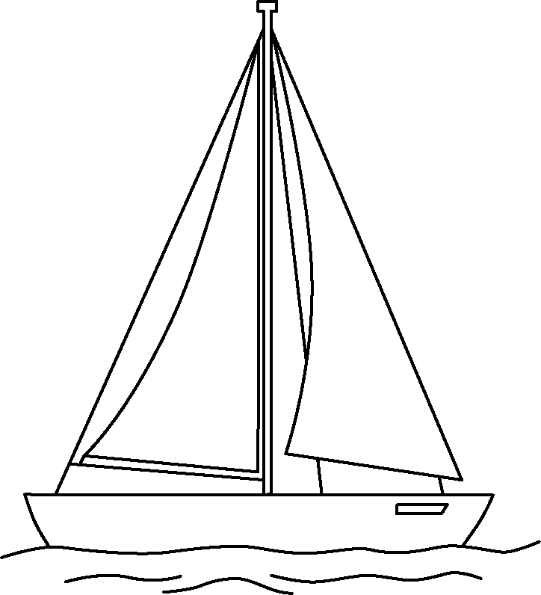

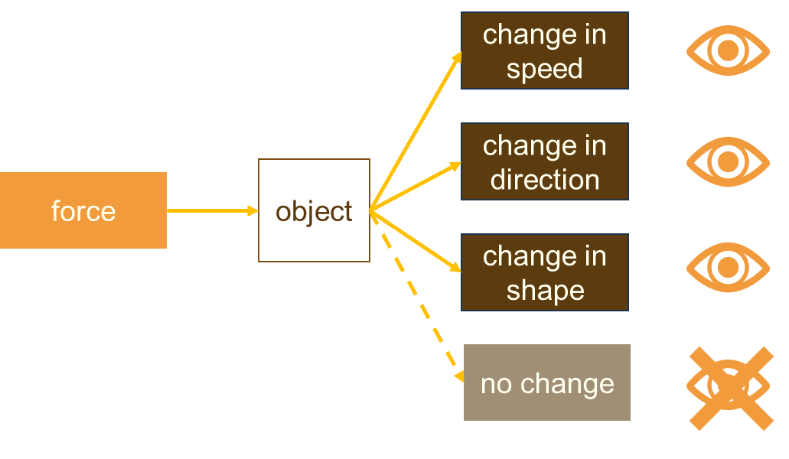
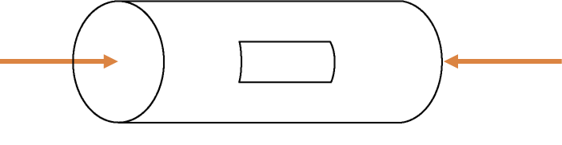
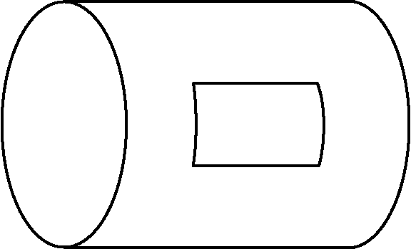

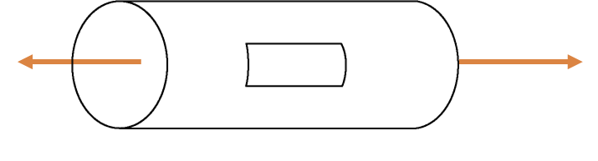
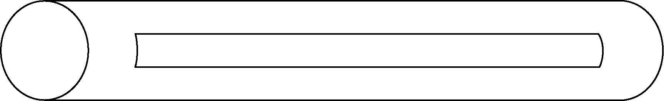

Fundamentals in physics
Forces and their interactions
Interaction:
When two objects influence each other and cause a pair of forces to arise.
Free-body force diagrams
upthrust force
on boat
by water
one force on each object
equal in size
opposite in direction
gravity force
on boat
by Earth
One object
Arrows to show size and direction of forces
Labelled forces:
What kind of force is acting?
What is the force acting on?
What exerts the force?
Forces can cause change:
A force cannot be seen acting but its effects often can.
Deforming forces
Forces can be contact or non-contact:
Contact forces arise between two touching objects.
Non-contact forces can act between two objects at a distance.
contact | thrust, friction, air resistance, water resistance, normal contact, upthrust
non-contact | gravity force, magnetic force
Two pushing forces cause compression: the object contracts.
Two pulling forces cause tension: the object extends.
Science | 7.02: Fundamentals in physics | Knowledge Organiser

Slide 2
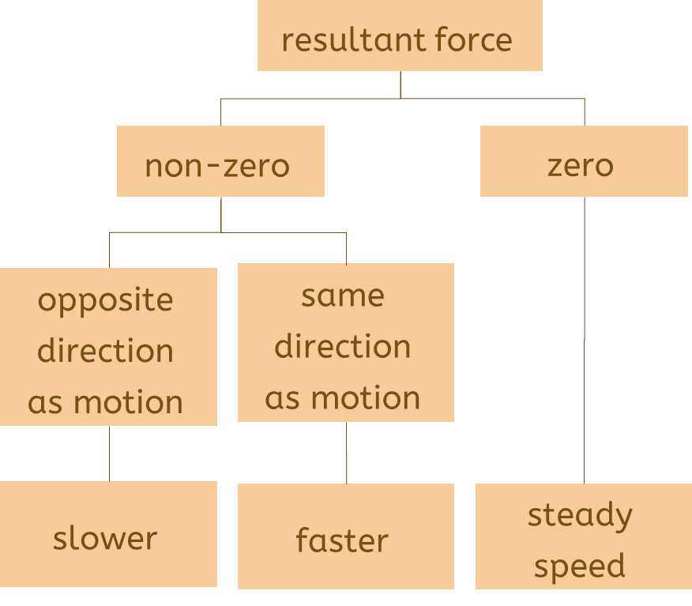
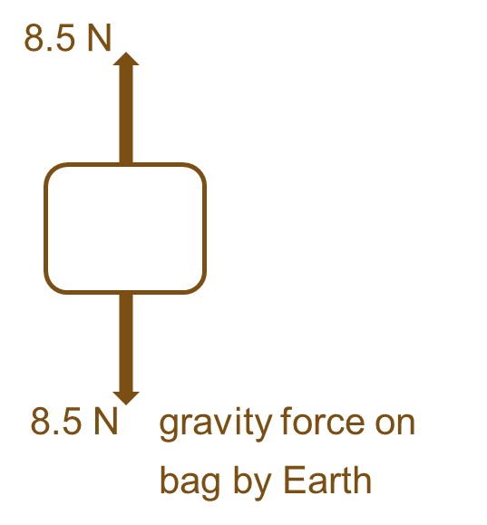
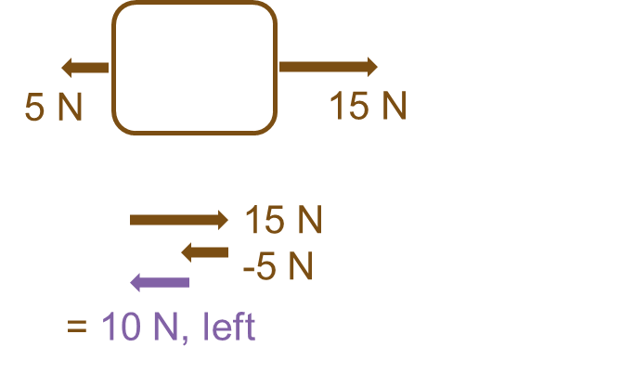
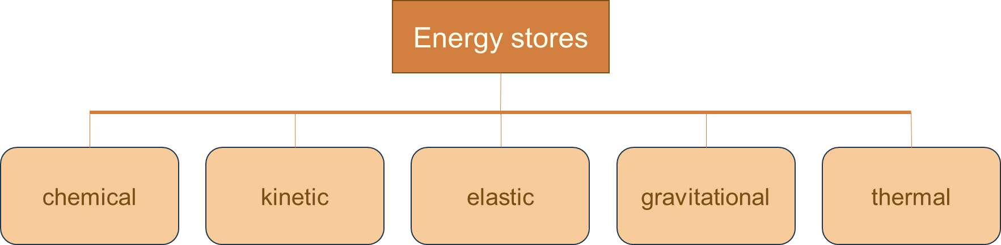
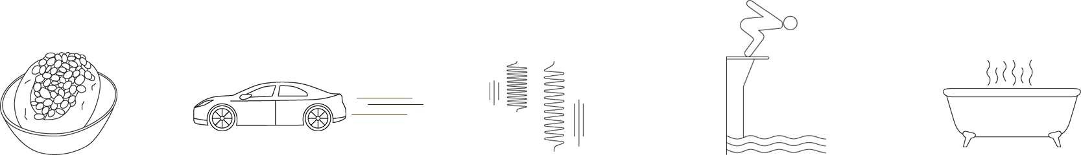
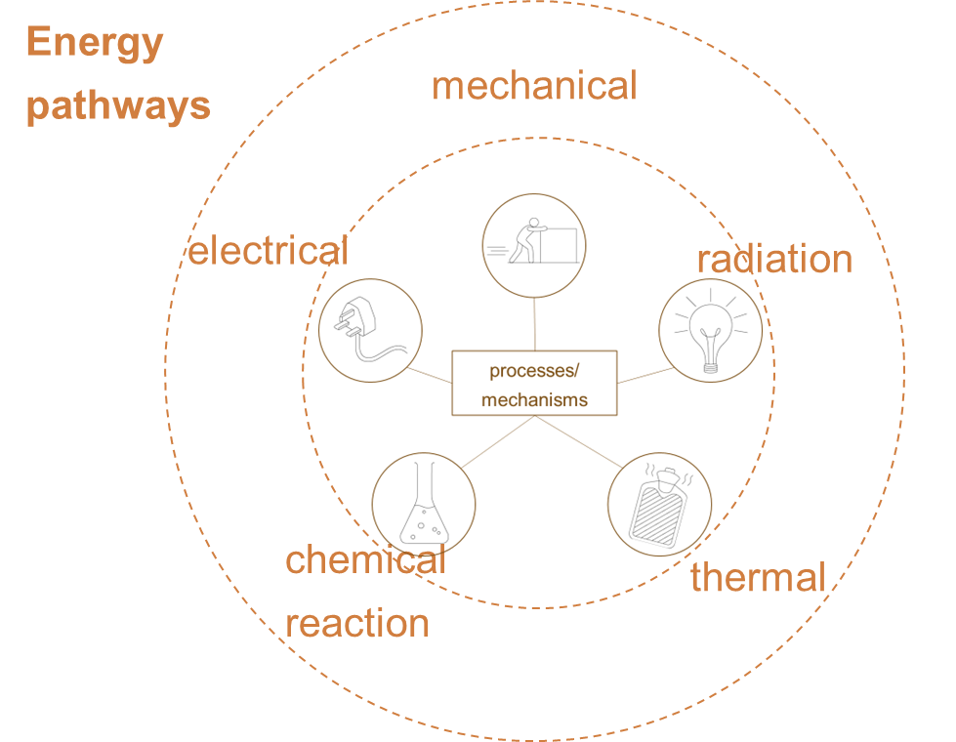

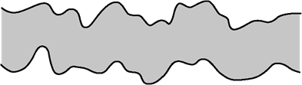
Fundamentals in physics
Combining forces
More than one force acting:
Their effects are combined
As if a single force is acting: the resultant force
unbalanced forces
balanced forces
Energy stores and pathways
moving steadily or at rest
What energy does:
Flows between objects in a system
Stays the same when it transfers
Cannot be used up
Energy is transferred between stores:
Friction force
What? One of three frictional forces. They act to resist motion.
Where? Acts between solid surfaces, along the surfaces.
When? An object is sliding or trying to. When starting to slide, the applied force must be larger than the limiting friction: so, an unbalanced force acts.
How? Opposite direction to the motion, or the applied force.
Why? Surfaces are uneven, so the ‘catching’ between them must be overcome.
Energy is transferred because of processes, by pathways:
 | Useful | Nuisance
Walking | ✓
Machines |  | ✓
Driving | ✓
Wear and tear |  | ✓
catching;
surfaces parted: no catching
lubricant
Science | 7.02: Fundamentals in physics | Knowledge Organiser

Slide 3
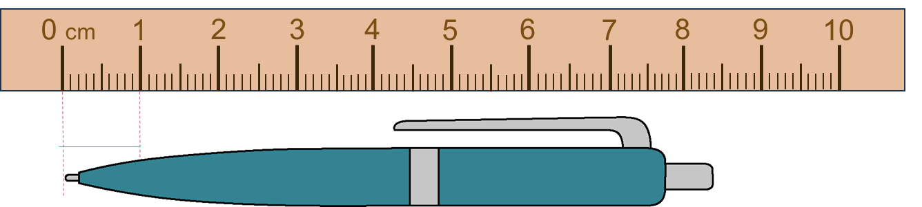
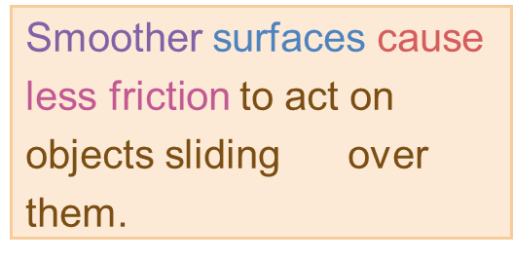

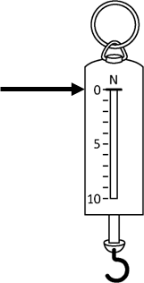
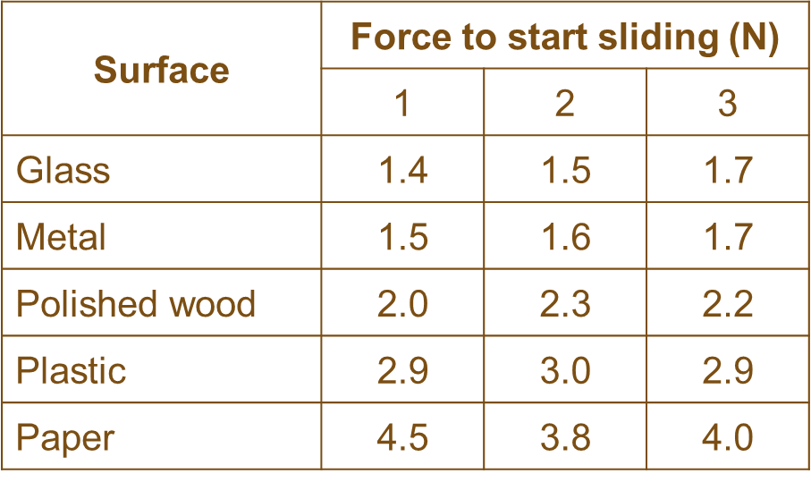
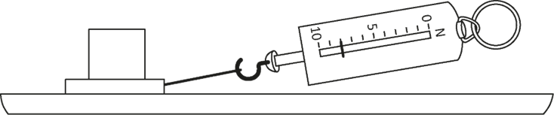

Fundamentals in physics
Modelling forces
Arrows (length represents size, direction of forces)
Forces are modelled because:
forces cannot be seen acting
there are many forces acting at a time
their size and direction have important effects on situations, so need to be shown.
Dot or rectangle shows simplified object
Observing by measurement
Using a scale
set of lines at equal increments
Labelled with numbers and units
upthrust force
on boat
by water
Labels describe type of force, object acted on and objects exerting force on it.
Investigating forces
Statement to answer an enquiry question.
Scientific methods:
With or without hypothesis
Manipulating variables or not
comparative term
present tense
Measuring instruments
Include rulers, balances, clocks and thermometers.
Force is measured using a force-meter.
the effect which can be tested
‘group’ being tested (IV)
Planning to collect high-quality data:
Measuring with skill
Preparing the data table
Repeatable data
headings describe variable
IV
DV
in columns
Check force-meter is on zero with no force.
Quantities: and their units
Base quantities: length (m), mass (kg), time (s) and temperature (K).
Derived quantities include force (N).
repeated
Peer review:
Peers (people of a similar level of knowledge) test the results for quality.
Repeatability:
Same group, same results
Reproducibility:
Different group, same results
Science | 7.02: Fundamentals in physics | Knowledge Organiser

